Slide 1
Operating Systems
Dr. Deepak Dembla
Topic: Resource Management

Slide 2
• Operating system as a resource manager
• Transformation of hardware devices into virtual devices
• Time division multiplexing
• Space division multiplexing
• Resource scheduling
• Hardware resources
• Virtual resources
• Software resources
• Nature of resources
• Goals of resource management
• Working of resource manager
• Components of resource management
Objectives

Slide 3
Resource Abstraction/Transformation
2. Resource Sharing/Multiplexing
Functions of a resource manager

Slide 4
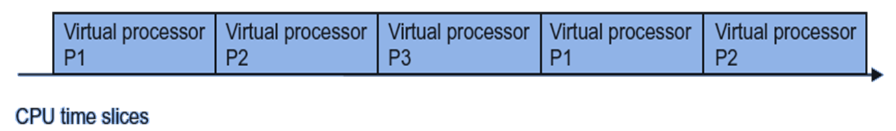
Time division multiplexing

Slide 5
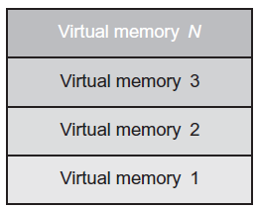
Space division multiplexing

Slide 6
Resource Scheduling
Job Scheduling
Process scheduling

Slide 7
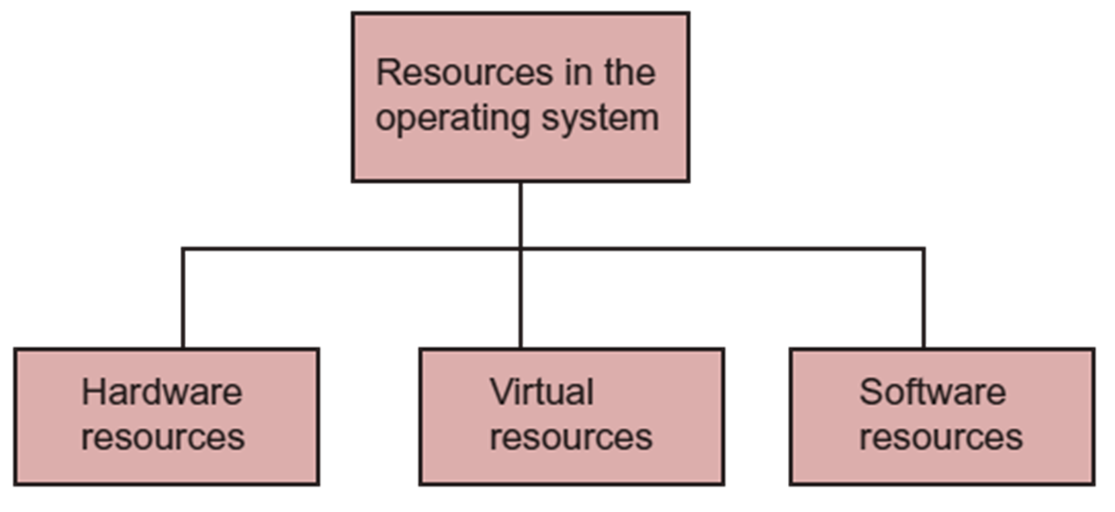
Resource types

Slide 8
Nature of resources
Non-Consumable Resources
Consumable Resources
Non-Preemptive Resources
Preemptive Resources

Slide 9
Goals of resource management
Resource Utilization
Protection
Synchronization
Deadlock
Fair distribution

Slide 10
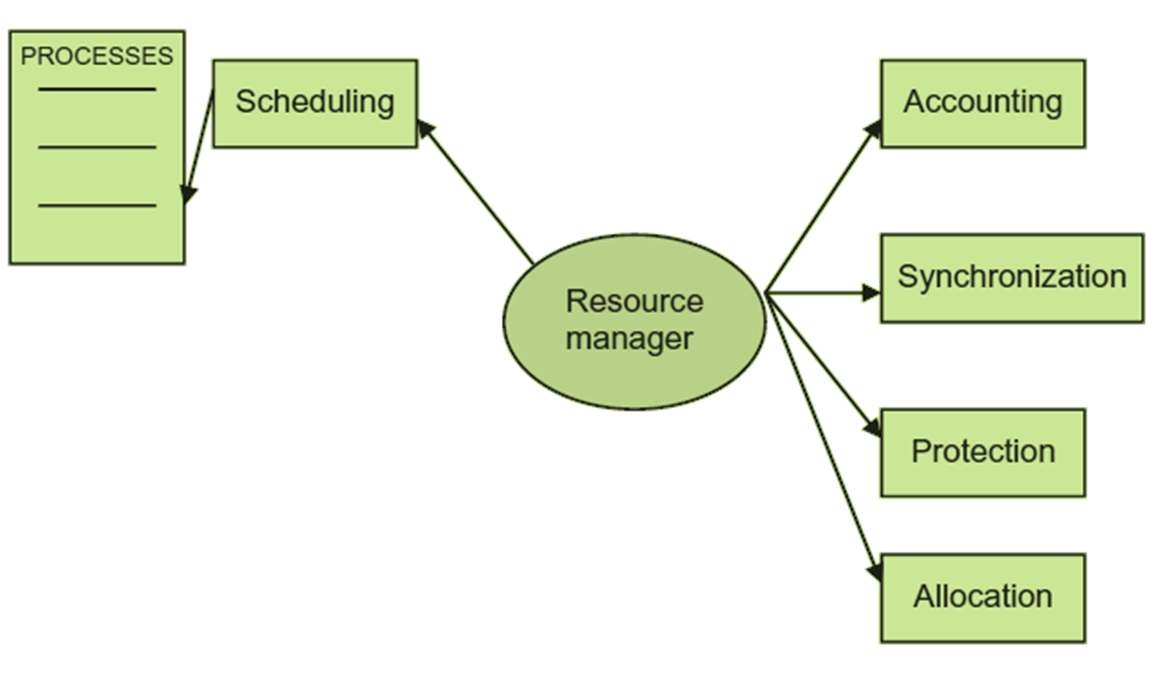
How resource manager works?

Slide 11
PROCESS/TASK MANAGEMENT
Process creation, deletion and other operations on process scheduling
Inter-process communication
Process synchronization
Deadlock management
Components of resource management

Slide 12
MEMORY MANAGEMENT
Keeps account of allocated space to the processes and available space
Partitions the memory as per fixed partition or variable partition methods
Allocates the memory to the processes as per contiguous or non-contiguous methods
Virtual memory management
Components of resource management

Slide 13
SECONDARY STORAGE MANAGEMENT
Free space management of secondary storage
Allocation on secondary storage
Disk scheduling
Swap space management on secondary storage
Components of resource management

Slide 14
FILE MANAGEMENT
File operations like creation, deletion, etc.
Directory creation and deletion
File allocation methods
File retrieval methods
Free space management
File protection
I/O MANAGEMENT SECURITY AND PROTECTION
Components of resource management

